Slide 1
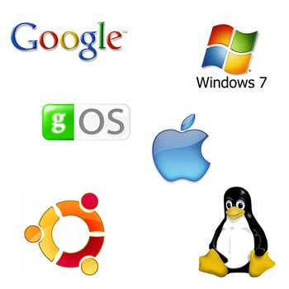
Operating System (OS) Forensics
Notes:
In this lecture, we will study another important topic in digital forensics, Operating System (OS) Forensics. OS Forensics is a very broad topic, covering a wide variety of forensic issues.

Slide 2
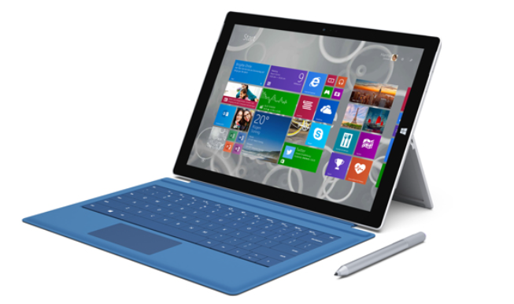
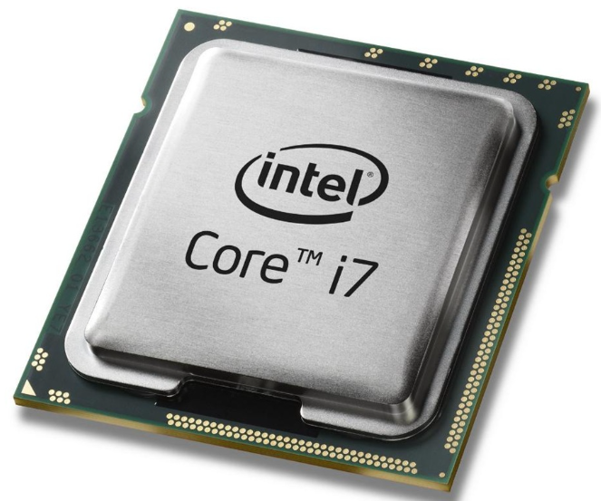



OS
Linux
Windows
Applications
Notes:
There are many Operating System (OS) available today. We will be focusing on two popular ones, Windows and Linux. Also, we may install a lot of applications on our computers. So we will take a look at the forensic implications of Windows and Linux as well as their installed applications.

Slide 3

Operating systems, such as Microsoft Windows XP and Linux, and installed applications, such as IE, store digital evidence in a variety of places.
Volatile Data Analysis
Volume and File System Analysis
Notes:
Operating systems, such as Microsoft Windows XP and Linux, and installed applications, such as IE, store digital evidence in a variety of places.
Before I proceed to discuss Operating System (OS) Forensics, I would like to emphasize that
volatile data analysis must be done if you are called onto a crime scene, discovering the computer is still on.
Also, you need to conduct Volume and File System Analysis.

Slide 4

Operating System Forensics
A broad topic
Operating System (OS) Forensics is the process of retrieving useful information from the Operating System (OS) of the computer or mobile device in question. The aim of collecting this information is to acquire empirical evidence against the perpetrator.
[1] Computer Forensics: Operating System Forensics.
https://resources.infosecinstitute.com/category/computerforensics/introduction/areas-of-study/digital-forensics/operating-system-forensics/#gref
Notes:
Operating System (OS) Forensics is the process of retrieving useful information from the Operating System (OS) of the computer or mobile device in question. The aim of collecting this information is to acquire empirical evidence against the perpetrator.
So the focus will be digital evidence generated by OS and its installed applications.

Slide 5

Too many
OS Forensics
Windows
Linux
Notes:
As mentioned, there are many Operating System (OS) available today. We will be focusing on two popular ones, Windows and Linux.

Slide 6
Windows Forensics
Notes:
We first take a look at Windows Forensics.

Slide 7
Windows Forensics
Windows Recycle Bin Forensics
Windows Registry Forensics
Internet Activity, such as IE Cache, Skype
Thumbnail database/cache files created and maintained by the various picture browsing and photo editing software products.
Microsoft Word Document Forensics
Windows Event
Notes:
Particularly, we will look at these topics in detail.
Please be advised that Windows Forensics is a very broad topic, and also a very complicated task if we want to completely investigate the forensic implications of the Windows operating system. Also, it is an ongoing research area as Windows as Microsoft continues to innovate and introduce new versions of Windows as well as more applications are developed and come into market.

Slide 8

Windows Recycle Bin Forensics
Notes:
We first quickly take a look at Windows Recycle Bin Forensics.

Slide 9
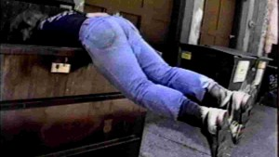
Dose of Reality:
Dumpster Diving
Dumpster diving is looking for treasure in someone else's trash. (A dumpster is a large trash container.)
Somebody's Trash is Someone Else's Treasure
Notes:
Today, it is not unusual that someone is looking for treasure in someone else's trash, also known as Dumpster diving.

Slide 10
Dose of Reality: (cont’d)
In the world of information technology, dumpster diving is the practice of sifting through commercial or residential trash to look for information that could be used to carry out an attack on a victim.
The information found can be anything from medical records, resumes, personal photos and emails, bank statements, account details or information about software, tech support logs and so much more.
Similarly, when you delete a file, it's usually moved to the Recycle Bin in your OS so that you can easily restore the deleted file as long as the Bin hasn’t been emptied.
Think Deleted Data Are Gone Forever?
Think Again!
Notes:
In the context of cyber security, dumpster diving is the practice of sifting through commercial or residential trash to look for information that could be used to carry out an attack on a victim.
Similarly, when you delete a file, it's usually moved to the Recycle Bin in your OS so that you can easily restore the deleted file as long as the Bin has not been emptied.
Somewhat analogous to the situation where if you throw your confidential document into your trash bin, it is vulnerable to dumpster diving attack. It must be shredded instead, which is similar to secure deletion in cyber security.

Slide 11
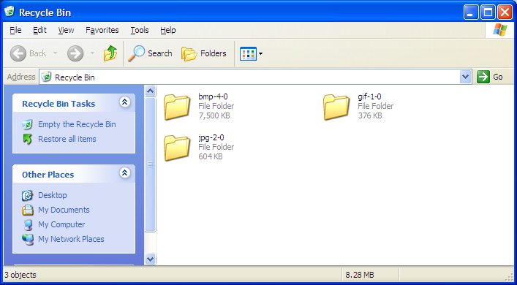
Deleting Files in Windows
When a file is deleted in Windows, including NT, XP, 2000, Vista, etc
The OS renames it and moves it to the Recycle Bin
Restore deleted files.
Notes:
When a file is deleted in Windows, your OS just renames it and moves it to the Recycle Bin. You can easily restore these deleted files in Windows.
[click]
Therefore, when you perform Windows Forensics, you would check the Recycle Bin.

Slide 12
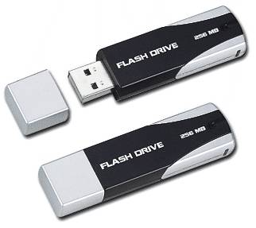
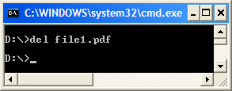

Deleting Files in Windows (cont’d)
In Windows, files in the Recycle Bin are stored in the
However, Files or folders deleted from removable media or using del at the command prompt are NOT stored in the Recycle Bin
or
Notes:
In Windows, files in the Recycle Bin are stored in the
C:\Recycled on FAT filesystem
C:\Recycler on NTFS filesystem
However, Files or folders deleted from removable media or using del at the command line are NOT stored in the Recycle Bin.

Slide 13


Deleting Files in Windows (cont’d)
Not in the Recycle Bin!
Recover Deleted Files
For example,
Notes:
What if these deleted files are not in the Recycle Bin? In other words, they are emptied from the Recycle Bin.
Then, we have to use the deleted file recovery techniques that we have learned when studying file system forensics. For example, using metadata-based file recovery or file carving.

Slide 14
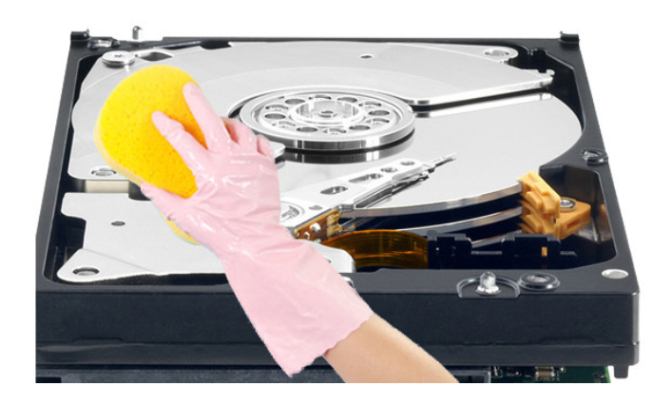
Secure Deletion
Secure deletion needs special applications (tools) that overwrite a deleted file's on-disk data using techniques to make disk data unrecoverable.
Anti-Forensics
[1] How to securely wipe sensitive files--or your entire hard drive.
http://www.pcworld.com/article/2039796/how-to-securely-wipe-sensitive-files-or-your-entire-hard-drive.html
Notes:
Regarding data recovery, I would like to mention an Anti-Forensic technique against data recovery again, which is Secure deletion.
However, in this case, it usually needs special applications (tools) that overwrite a deleted file's on-disk data using techniques to make disk data unrecoverable.

Slide 15
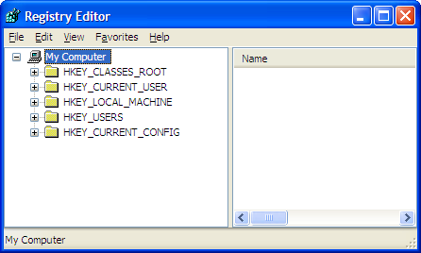
Windows Registry Forensics
[1] Harlan Carvey. Windows Registry Forensics: Advanced Digital Forensic Analysis of the Windows Registry. Syngress. ISBN-10: 1597495808
[2] Daniel Ogden. Windows Registry.
http://appdevissues.tripod.com/downloads.htm
[3] Demystifying the Windows Registry.
http://www.bleepingcomputer.com/tutorials/tutorial74.html
Notes:
Next, we will look at a unique OS forensic research area in Windows Forensics, Windows Registry Forensics, which is a very important area in Windows Forensics.

Slide 16

Understanding the Windows Registry
Registry
A hierarchical database that stores hardware and software configuration information, network connections, user preferences, and setup information
quite complex => nightmare to configure correctly
For investigative purposes, the Registry can contain valuable evidence
Lots of ……
Notes:
We first go through some basics of Windows Registry.
Technically speaking, Windows Registry is a database, particularly, a hierarchical database that stores hardware and software configuration information, network connections, user preferences, and setup information,
It is quite complex, and would be a nightmare to configure correctly.
Nevertheless, the Windows registry is a very useful tool for the forensic investigator and system administrator.
Please note that newer Windows versions keep popping up with newer features and updates, making Windows Registry be very hard to analyze.

Slide 17

Understanding the Windows Registry (cont’d)
To view the Registry, you can use:
Regedit (Registry Editor) program
A word of warning! Use caution when editing the Registry. If you use RegEdit to alter the registry you can corrupt the registry. Incorrect changes to this file may render your system unusable. Your system may not even boot up. In many cases Windows automatically replaces the corrupted registry with a good backup it has stored, but don't rely on this feature to rescue you.
Notes:
You can use a Regedit (Registry Editor) program provided in Windows to view the Registry.
However, use caution when editing the Registry. I don’t recommend you to touch the Registry if you don’t know what you are doing.
If you use RegEdit to alter the registry you can corrupt the registry. Incorrect changes to this file may render your system unusable. Your system may not even boot up.

Slide 18

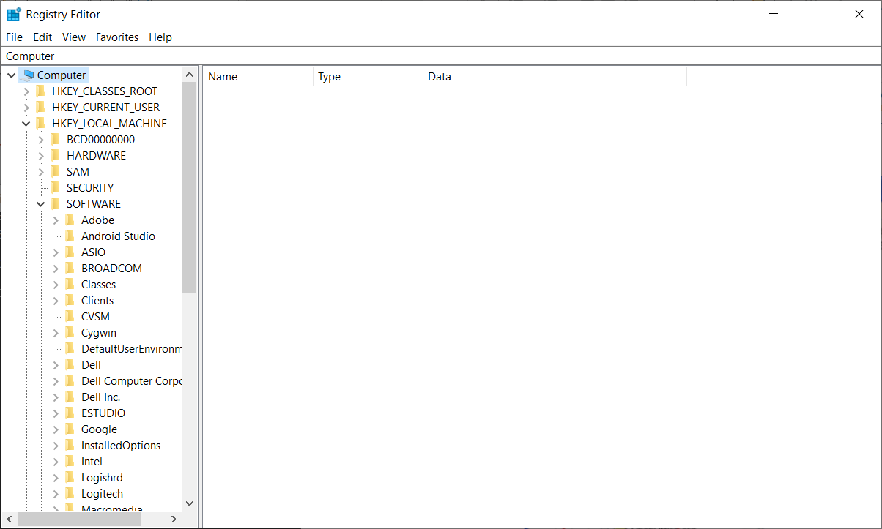
Hives
Keys
Sub-folder
Subkeys
Sub-folder
Viewing HKEYs in the Windows Registry Editor
[1] Windows Registry Analysis 101
https://www.forensicfocus.com/articles/windows-registry-analysis-101/
Notes:
This is an example view of the Windows Registry Editor (Regedit).
As mentioned before, Windows Registry is a hierarchical database. It is similar to file system directories. Both the Windows registry and the file system are organized in a hierarchical structure (tree structure).
Each main folder in the Windows registry is known as a “Hive”, which is a logical group of keys, subkeys, and values in the registry. Hives are made of a combination of sub folders, called “Keys”. These Keys contain Sub Keys with configuration information in Windows.

Slide 19
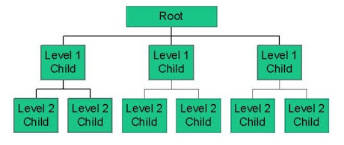
Exploring the Organization of the Windows Registry
Five Hives (Root Keys or HKEYs)
HKEY_CLASSES_ROOT (HKCR)
stores information about registered applications, such as file associations, tying them to the applications used to handle these items.
HKEY_CURRENT_USER (HKCU)
stores settings that are specific to the currently logged-in user. The HKCU key is a link to the subkey of HKEY_USERS that corresponds to the user
HKEY_LOCAL_MACHINE (HKLM)
Stores settings that are specific to the local computer.
HKEY_USERS (HKU)
Pre-logon default user profile information and HKEY_CURRENT_USER key
HKEY_CURRENT_CONFIG (HKCC)
contains information gathered at runtime; information stored in this key is not permanently stored on disk, but rather regenerated at the boot time. It is a link to HKEY_LOCAL_MACHINE\System\CurrentControlSet\Hardware Profiles\Current
“Handle to Registry Key”
In a hierarchical model, data is organized into a tree-like structure.
Hierarchical Database Model
Notes:
There are five main Hives in the Windows Registry. The hives are also known as Root Keys (or HKEYs, which stands for Handle to Registry Key). Different names but the same meaning.
The Windows Registry includes
HKEY_CLASSES_ROOT (HKCR)
HKEY_USERS (HKU)
HKEY_CURRENT_USER (HKCU)
HKEY_LOCAL_MACHINE (HKLM)
HKEY_CURRENT_CONFIG (HKCC)
Note that a hive is a logical section or a main folder in the Windows Registry. It is a logical group of keys, subkeys, and values in the registry.
Each hive contains some unique information. For example, HKEY_CURRENT_USER (HKCU) stores settings that are specific to the currently logged-in user.
Also, Windows Registry is a hierarchical database. In a hierarchical model, data is organized into a tree-like structure.

Slide 20
Exploring the Organization of the Windows Registry (cont’d)
Registry terminology:
Registry: The registry contains two basic elements: keys and values.
Note that the Windows Registry is split into a number of logical sections, or five "hives” (A hive is a logical group of keys, subkeys, and values in the registry )
Keys: Registry Keys are similar to folders - in addition to values, each key can contain subkeys, which may contain further subkeys.
Values: are a bit like the files in the folders, and they contain the actual settings.
Notes:
Next, let us take a look at the definitions of two important concepts in the Windows Registry, which are keys and values.
The Windows registry contains two basic elements: keys and values.
It is similar to file system directories. The Registry Keys are similar to folders, and each key can contain subkeys, which may contain further subkeys.
Values are a bit like the files in the folders, and they contain the actual settings and configurations used by components, services, applications in Windows.

Slide 21
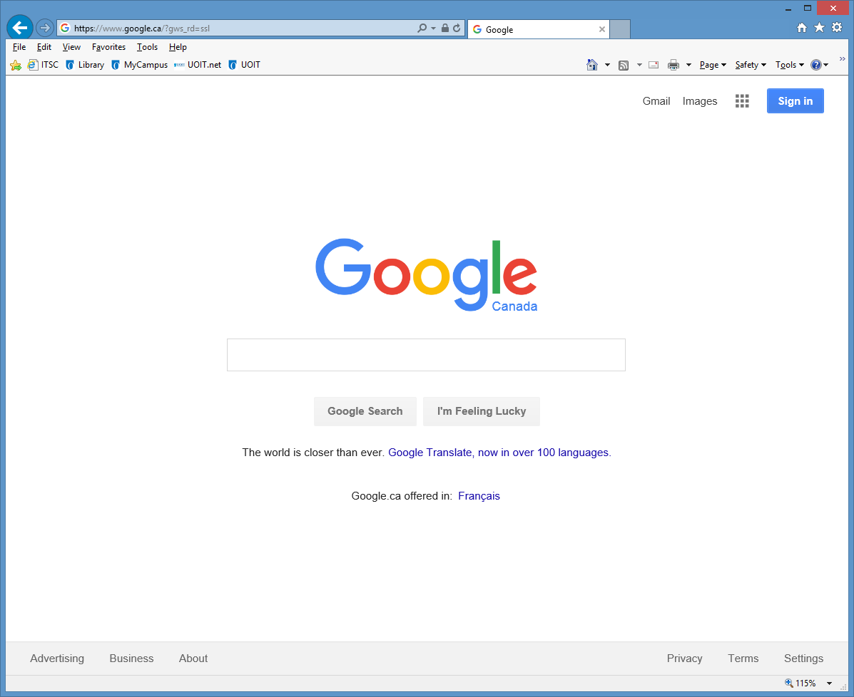
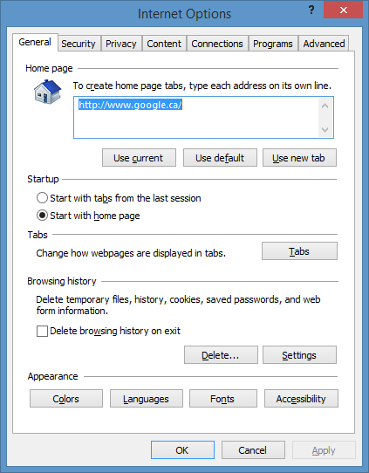
Notes:
Next, let us take a look at a real example. Particularly, we look at a popular setup for Web Browser. As you already known, you can set up a home page in your Web Browser, for example, you set google as your home page for Microsoft Internet Explorer (IE). Actually, this setting will be saved in the Windows Registry.

Slide 22
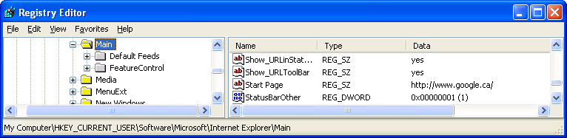
An example Registry key, which controls what your initial start page will be when using Internet Explorer.
HKEY_CURRENT_USER\Software\Microsoft\Internet Explorer\Main\\Start Page
When we break this Key down to its components we can see the following:
HKEY_CURRENT_USER is the Hive that this key is associated with.
Software is a Key; Microsoft - This is a Subkey
Internet Explorer - This is a Subkey; Main - This is a Subkey
Start Page - This is the Value that the actual data is stored in. For this particular Value, the data will be the start page that you want Internet Explorer to use, i.e., http://www.google.ca/
Notes:
So you go to
HKEY_CURRENT_USER\Software\Microsoft\Internet Explorer\Main
And check the value “Start Page”. You will find out the google website has been saved into the value “Start Page”.
[click]
If we break this Key down to its components we can see the following:
HKEY_CURRENT_USER is the Hive that this key is associated with.
[click] Software is a Key; [click] Microsoft - This is a Subkey
[click] Internet Explorer - This is a Subkey; [click] Main - This is a Subkey
[click] Finally, Start Page - This is the Value that the actual data is stored in. For this particular Value, the data will be the start page that you want Internet Explorer to use, i.e., http://www.google.ca/

Slide 23
Exploring the Organization of the Windows Registry (cont’d)
Each key has one or more values. There are 3 parts in value, which are Name, Type and Data, as shown in the Table below.
Value Parts | Description
Name | Every value has a unique name in that particular key.
Type | Value's type determines the type of data that value contains. The common value types in registry for instance are: REG_BINARY type contains binary data; REG_DWORD type contains double-word (32-bit) data; REG_SZ type contains fix-length string data.
Data | Value's data contains data which usually relates to the value's type.
[1] Lih Wern Wong. Forensic Analysis of the Windows Registry.
http://www.forensicfocus.com/forensic-analysis-windows-registry
Notes:
Each key has one or more values. There are 3 parts in a value, which are Name, Type and Data.
Every value has a unique name in that particular key.
Value's type determines the type of data that value contains. The common value types in registry for instance are: binary data, double-word (32-bit) data and string data.
Value's data contains the actual content which usually relates to the value's type.

Slide 24
An Example of Windows Registry Value
Name: Start Page
Type: REG_SZ, fix-length string data
Data: http://www.google.ca/
Notes:
Let us take at the previous example value again.
The Name of the value is “Start Page”,
The Type is the string data, and
the actual Data is the web link of google search engine, http://www.google.ca/

Slide 25


Examining the Windows Registry
[1] Harlan Carvey. Windows Registry Forensics: Advanced Digital Forensic Analysis of the Windows Registry. Syngress. ISBN-10: 1597495808
[2] Derrick J. Farmer. A Forensic Analysis Of The Windows Registry
http://www.forensicfocus.com/a-forensic-analysis-of-the-windows-registry
Notes:
As mentioned, the Windows registry is a very useful tool for the forensic investigator. For a Forensic analyst, the Windows Registry is a treasure box of information.
It is the database that contains the default settings, user- and system-defined settings in windows computer. Registry serves as repository, monitoring, observing and recording the activities performed by the user in the computer.

Slide 26
Internet Usage
Accessing the Internet leaves a wide variety of information in a computer's Registry including
Websites viewed,
network storage accessed,
and newsgroups accessed
Some Internet browsers record how many times a given page was visited, while others keep records of the last 10 typed URLs, for example, Microsoft IE. Applications such as Instant messenger programs also retain list of users' contacts in the Registry.
[1] Vivienne Mee, Theodore Tryfonas, and Iain Sutherland. The Windows Registry as a forensic artefact: Illustrating evidence collection for Internet usage. Digital Investigation, Vol. 3, No. 3, Sep. 2006, pp: 166-173
Notes:
For example, accessing the Internet leaves a wide variety of information in a computer's Registry including Websites viewed.
Some Internet browsers even keep records of the last 10 typed URLs, for example, Microsoft IE.
Note that we talk about the web URLs manually typed by the user.

Slide 27

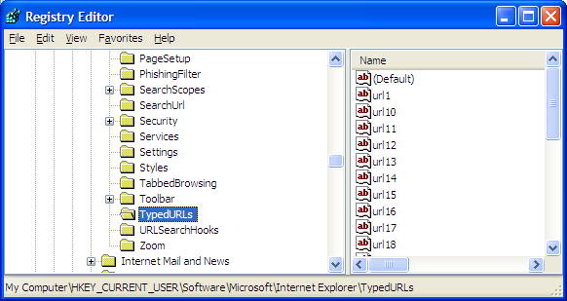
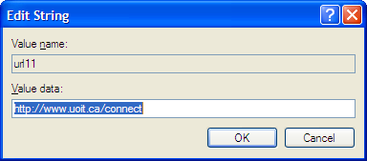
Find Items Relating to Internet Usage - Typed URLs
HKEY_CURRENT_USER\Software\Microsoft\Internet Explorer\TypedURLs
Specific to the user currently logged in to Windows
Notes:
Forensic examiners many times rely on the TypedURLs Registry key, which can be found in the root key HKEY_CURRENT_USER\Software\Microsoft\Internet Explorer\TypedURLs.
Of course, you know that the TypedURLs Registry key is specific to the user currently logged in to Windows. So you know who typed these URLs.
As the name indicates, this artifact contains the URLs that is typed into the Internet Explorer browser.
You may be wondering why this evidence is so important.

Slide 28

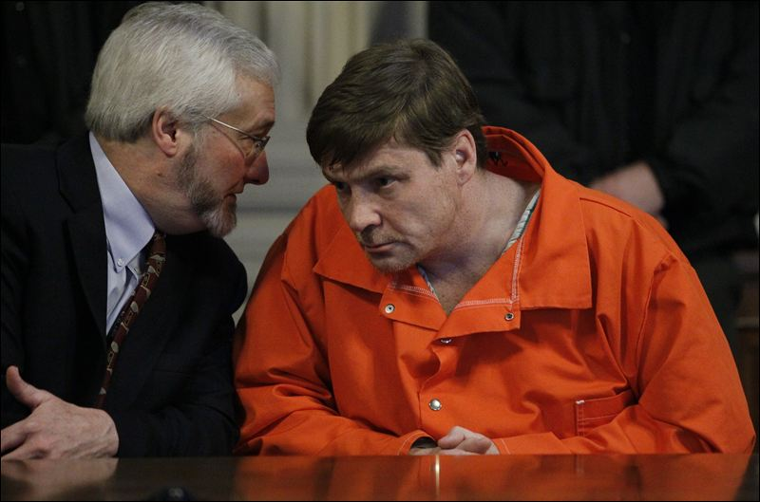
Dose of Reality:
You typed these URLs!
[1] Connecticut v. Amero
https://en.wikipedia.org/wiki/Connecticut_v._Amero
[2] Was Julie Amero wrongly convicted?
https://www.theregister.com/Print/2007/02/14/julie_amero_case/
Notes:
I believe you may hear some court case, for example, a suspect is found viewing some inappropriate websites.
It is very common that the suspect would defend his or her reputation by saying that I didn't go there, but it is caused by malware.
[click]
However, you may use the TypedURLs Registry key to check if the suspect physically typed the URLs in.
Of course, the real work is more complicated and tricky. For example, you must be aware that the behave of the TypedURLs key could be different for different versions of both Internet Explorer and Windows. Also, it is becoming increasingly common for some of the TypedURLs entries to be written by malware and not typed by the user at all.

Slide 29
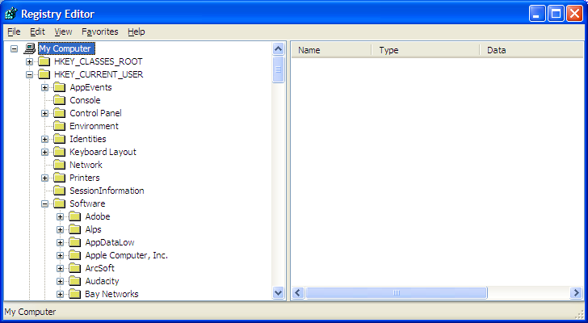
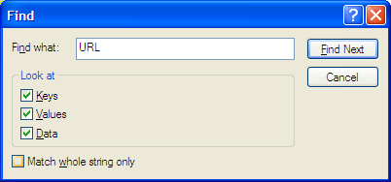
Keyword Searches
searching for keywords such as “URL”, “Internet”, and “MSN” are useful in some cases.
Notes:
Another popular Windows Registry Forensic Analysis technique is keyword search. For example, you can search for keywords such as “URL”, “Internet”, and “MSN”, and keyword search could be very useful in some cases.

Slide 30
Usernames and Passwords
Various usernames and passwords are stored in the Windows Registry. The most common source of usernames and passwords are the Internet Explorer Protected Storage data.
The base key of the Protected Storage is located under the following key:
“HKEY_CURRENT_USER\Software\Microsoft\Protected Storage System Provider”.
[1] Nir Sofer, 2005 Nir Sofer, Protected Storage PassView v1.62, NirSoft Nir Sofer (2005). http://www.nirsoft.net/.
Notes:
Also, there are a lot of usernames and passwords stored in the Windows Registry. The most common source of usernames and passwords are the Internet Explorer Protected Storage data. The base key of the Protected Storage is located under the following key:
“HKEY_CURRENT_USER\Software\Microsoft\Protected Storage System Provider”.

Slide 31
Usernames and Passwords (cont’d)
Information that could be stored in Protected Storage includes
MSN and Internet Explorer AutoComplete strings and passwords, Microsoft Outlook and Outlook Express accounts' passwords, and MSN Messenger password.
Registry Editor hides these registry keys from users viewing, including administrator.
There are tools that allow examiner to view the decrypted Protected Storage on a live system, such as Protected Storage PassView (NirSoft, 2004) and PStoreView (PStoreView, 2005).
[1] Nir Sofer, Protected Storage PassView v1.62, NirSoft Nir Sofer (2005). http://www.nirsoft.net/.
Notes:
However, Registry Editor hides these registry keys from users viewing, even including administrator.
So you need third party tools to view the decrypted Protected Storage on a live system, such as Protected Storage PassView from NirSoft.

Slide 32

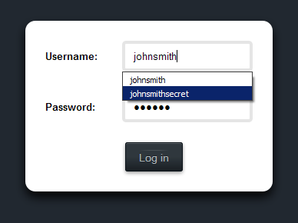
Internet Explorer AutoComplete
Notes:
Recall AutoComplete in Internet Explorer: When you visit a website that requires you to sign in to your account—like an email, banking, or shopping site,
Internet Explorer will ask if you want your user name and password remembered. If you answer yes, the next time you visit the site and start entering your user name, Internet Explorer will automatically finish filling in your account info.
It is known as AutoComplete. It saves you time by remembering passwords and other info you enter into forms online.
You may be wondering where Windows store these username and password. They are stored in the Windows Registry.

Slide 33
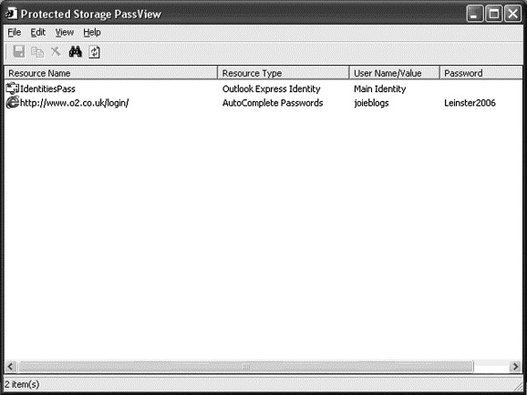
Usernames and Passwords (cont’d)
Protected Storage PassView by Nir Sofer showing an AutoComplete username and password from the Protected Storage of the Registry.
Notes:
This is an example view of PassView by Nir Sofer showing showing an AutoComplete username and password from the Protected Storage of the Registry.
Please note that Registry Editor hides these registry keys from users viewing, even including administrator.

Slide 34

Data Hiding in Registry
Suspect can hide all sorts of data including password, text information, and binary files in registry. Suspect can effectively hide data in registry keys' value entries.
By using different encoding techniques, suspect could obfuscate or hide data from forensic examiner.
Unless forensic examiner knows the relevant keywords to search in the registry, finding hiding data in tens of thousands of registry keys can be a tedious task.
[1] Lih Wern Wong. Forensic Analysis of the Windows Registry.
http://www.forensicfocus.com/forensic-analysis-windows-registry
Notes:
Unfortunately, we face a big challenge: Suspect can hide all sorts of data including password, text information, and binary files in registry, but it is very hard to detect these hidden data.

Slide 35

Many different types of data are present in the registry that can provide evidence of program execution, application settings, malware persistence, and other valuable artifacts. Discovering these data can be useful to discover malicious activity and to determine what data may have been stolen.
More and more Registry Keys of Forensic Value should be investigated.
[1] Lih Wern Wong. Forensic Analysis of the Windows Registry.
http://www.forensicfocus.com/forensic-analysis-windows-registry
[2] David Via. Digging Up the Past: Windows Registry Forensics Revisited. Jan. 2019
https://www.fireeye.com/blog/threat-research/2019/01/digging-up-the-past-windows-registry-forensics-revisited.html
Notes:
Windows registry data has been frequently utilized when performing forensic analysis of computer system and computer network as part of digital forensics and incident response.
Many different types of data are present in the registry that can provide evidence of program execution, application settings, malware persistence, and other valuable artifacts.
Discovering these data can be useful to discover malicious activity and to determine what data may have been stolen.
Therefore, more and more Registry Keys of Forensic Value should be investigated.

Slide 36

Best tool for registry analysis in forensics examinations
Notes:
One of the best tool for registry analysis in forensics examinations is RegRipper. It is an open source tool, written in Perl, for extracting/parsing information (keys, values, data) from the Windows Registry and presenting it for analysis.

Slide 37

Non-graded hands-on exercise
- Registry Keys of Forensic Value
Through some experiments, discover one Registry Key that is of forensic value in your opinion.
Notes:
Next, I have a non-graded hands-on exercise for you to have some fun. Through some experiments, discover one Registry Key that is of forensic value in your opinion.

Slide 38
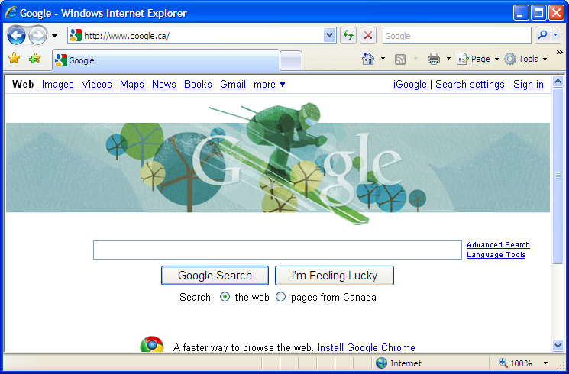
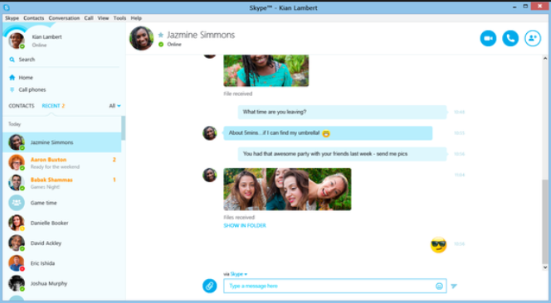
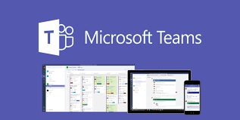
Internet Activity
Notes:
The next topic in Windows Forensics I would like to discuss is how to detect user online activities.

Slide 39


Dose of Reality:
Make travel arrangements online
keep in touch with friends using social media
Your OS (applications) records your Internet activity
Notes:
No matter you make travel arrangements online or keep in touch with friends using social media, Your OS (applications) records your Internet activity.

Slide 40


Dose of Reality: (cont’d)
Notes:
It is very unfortunate that we witness people missing very often.

Slide 41

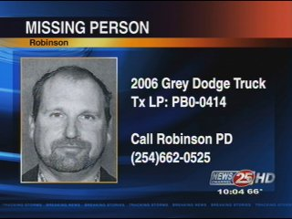
Dose of Reality: (cont’d)
Traditional Ways
Notes:
In the past, you will see stories of missing persons on broadcast news or missing person poster/missing flyer distributed, which is the traditional way.

Slide 42
Dose of Reality: (cont’d)
New Ways
Nova Scotia Missing Persons Act provides police access to a wide variety of personal records that may assist in locating a missing person.
These include cellphone records, text messages, internet-browsing history, GPS information, and so on.
Notes:
However, the police now also check the missing person’s cellphone records, text messages, internet-browsing history, GPS information, and so on.
Also, the government even establishes the law, such as Nova Scotia Missing Persons Act, which provides police access to a wide variety of personal records that may assist in locating a missing person, including their cellphone records, text messages, internet-browsing history.

Slide 43
Web Browsing Forensics
During most investigations, an individual's web browsing activity often provides investigative leads.
Currently, there are many web browsers we may encounter during computer related investigations, for example,
Microsoft's Internet Explorer (IE), Google Chrome, and the Firefox/Mozilla/Netscape family.
Each of these browsers saves the web browsing activity (also known as web browsing history) in their own unique formats.
[1] Web Browser Forensics, Part 1.
http://www.securityfocus.com/infocus/1827
Notes:
We first take a look at Web Browser Forensics.
During most investigations, an individual's web browsing activity often provides investigative leads.
Currently, There are many browsers we may encounter during computer related investigations,
Each of these browsers saves the web browsing activity (also known as web browsing history) in their own unique formats.

Slide 44



Browser
Notes:
There are many browsers available now. Among them, Internet Explorer, developed by Microsoft, is widely used by Internet users.
So we will take a look at how Internet Explorer stores the users’ web browsing activity.

Slide 45

Microsoft's Internet Explorer (IE)
In the Microsoft Windows operating system, a file called index.dat is used by the Internet Explorer web browser to store all of the Web sites that you have ever visited. Separate index.dat files exist for the Internet Explorer
history: website browsing history, the most-recent websites users have visited.
cache: stored temporary Internet files from the most-recent websites users have visited, which are used to improve browsing performance.
cookies: small files have been used to store some information on your computer by some websites, such as your preferences when visiting that site. Cookies can also store personally identifiable information, such as your name, e-mail address, home or work address, or telephone number. However, a Web site only has access to the personally identifiable information that you provide.
Notes:
In the Microsoft Windows operating system, a file called index.dat is used by the Internet Explorer web browser to store all of the Web sites that you have ever visited. Separate index.dat files exist for the Internet Explorer.
By analyzing users’ web browsing activity by Microsoft's Internet Explorer (IE), you can know
website browsing history,
stored temporary Internet files from the most-recent websites users have visited,
cookies: . text files with small pieces of data — like a username and password — that are used to store some information on your computer by some websites to identify your computer as you use a computer network. Technically speaking, Cookies let websites remember you, your website logins, shopping carts and more.

Slide 46

Microsoft's Internet Explorer (IE) (Cont’d)
Cached Information
For example,
C:\Documents and Settings\<Username>\Local Settings\Temporary Internet Files\Content.IE5\
(The directory listed above stores the cached pages and images the user reviewed on his computer.)
C:\Documents and Settings\<Username>\Local Settings\History\History.IE5\
(The above directory contains the Internet history activity without locally cached web content.)
C:\Documents and Settings\<Username>\Cookies\
History
Cookies
Notes:
For example, In Windows XP, you can go to
C:\Documents and Settings\<Username>\Local Settings\Temporary Internet Files\Content.IE5 for cached temporary Internet files from the most-recent websites users have visited,
C:\Documents and Settings\<Username>\Local Settings\History\History.IE5\ for website browsing history,
C:\Documents and Settings\<Username>\Cookies\ for cookies.

Slide 47
Microsoft's Internet Explorer (IE) (Cont’d)
However, those Index.dat files, which are used by Internet Explorer and Windows to store history, Internet cache, cookies, can be very hard to find.
If you are in Windows, even with "Show hidden files and folders" enabled, index.dat files are not visible and cannot be found if you do a search for index.dat files. The reason that these files are so invisible is that they are not just hidden, they have been designated as "system" files.
Notes:
However, those Index.dat files, which are used by Internet Explorer and Windows to store history, Internet cache, cookies, can be very hard to find.
Because they are hidden, and also have been designated as "system" files.

Slide 48
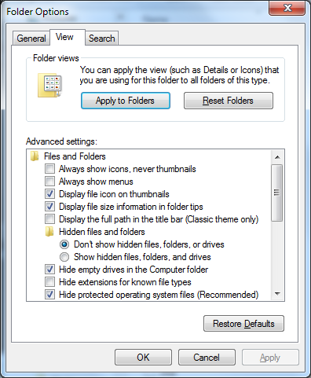
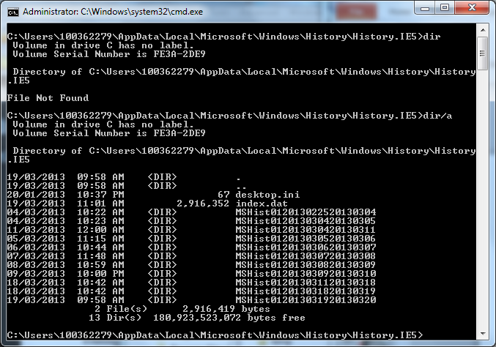
Microsoft's Internet Explorer (IE) (Cont’d)
[1]
[2]
Notes:
So you have to do a little bit more.
There are two ways: either show hidden files using Command Lines, for example, shows all hidden files using dir,
or make them visible in File browser.

Slide 49
Pasco, an Internet Explorer activity forensic analysis tool.
Notes:
The most popular Internet Explorer activity forensic analysis tool is Pasco.

Slide 50

Pasco shows that IE saves the following fields from a single web site visit in the Index.dat file:
The record type - Pasco signifies the activity is either a URL that was browsed or a website that redirected the user's browser to another site.
The URL - The actual website that the user visited.
Modified Time - The last moment in time the website was modified.
Access Time - The moment in time the user browsed the website.
Filename - The local file name that contains a copy of the URL listed.
Directory - The local directory you can find the "Filename" above.
HTTP Headers - The HTTP headers the user received when he browsed the URL.
For each row listed in the spreadsheet, you can retrieve the file listed in "Filename" in User's local directory named "Directory" to recreate what User saw on the web at the time listed in "Access Time."
Notes:
Pasco shows that IE saves the following fields from a single web site visit in the Index.dat file, for example,
The URL - The actual website that the user visited.
Access Time - The moment in time the user browsed the website.
Filename - The local file name that contains a copy of the URL listed.
Directory - The local directory you can find the "Filename" above.

Slide 51

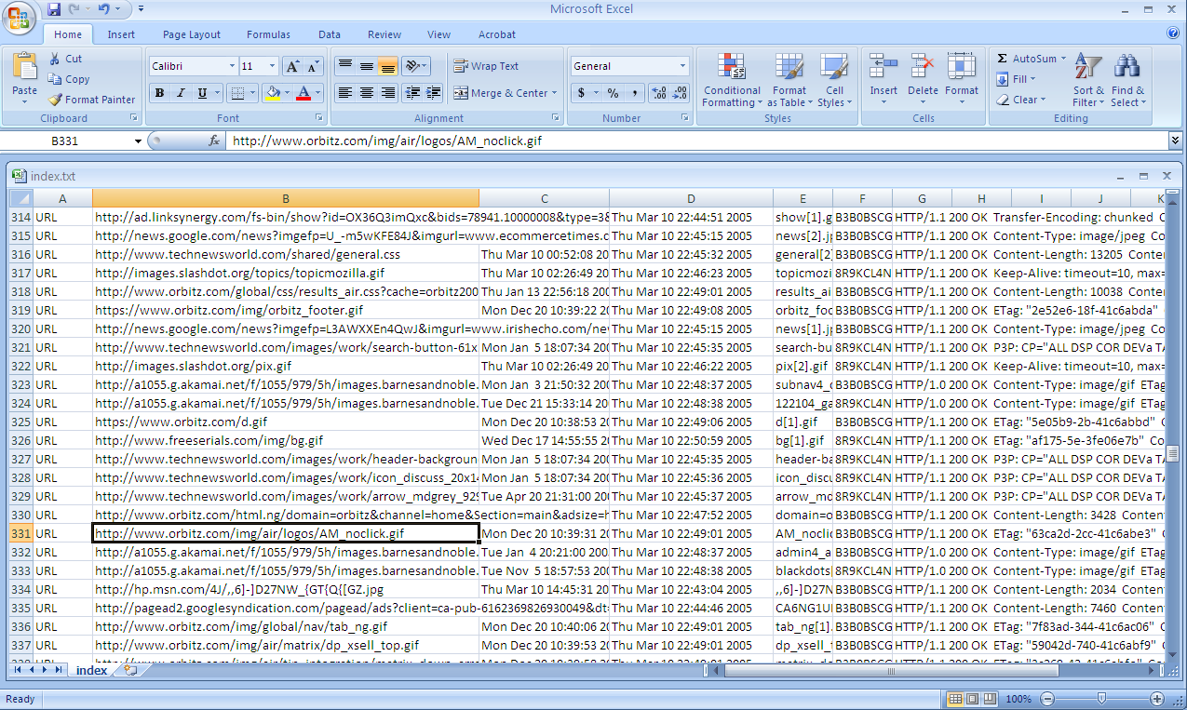

Notes:
This is an example view of Pasco.

Slide 52

Microsoft Edge web browser
Edge Artefacts
The Edge settings are stored in the following Extensible Storage Engine (ESE) database:
\Users\user_name\AppData\Local\Packages\Microsoft.MicrosoftEdge_xxxxx\AC\MicrosoftEdge\User\Default\DataStore\Data\nouser1\xxxxx\DBStore\spartan.edb
The Edge cached files stored in the following directory:
\Users\user_name\AppData\Local\Packages\Microsoft.MicrosoftEdge_xxxx\AC\#!001\MicrosoftEdge\Cache\
The Edge last active browsing session is stored in the following directory:
\Users\user_name\AppData\Local\Packages\Microsoft.MicrosoftEdge_xxxx\AC\MicrosoftEdge\User\Default\Recovery\Active\
Being Microsoft there is a legacy version of IE (version 11) included in Windows 10 (just in case you don’t like the new browser) and both Edge and IE history records are stored in the same database:
\Users\user_name\AppData\Local\Microsoft\Windows\WebCache\WebCacheV01.dat
[1] https://www.foxtonforensics.com/browser-history-examiner/microsoft-edge-history-location
[2] Windows 10 - Microsoft Edge Browser Forensics
https://www.linkedin.com/pulse/windows-10-microsoft-edge-browser-forensics-brent-muir
Notes:
Microsoft Edge, previously known as “Spartan” is an all new “universal” Microsoft application.
Since IE10 browsing history records are no longer stored in Index.DAT files, but are instead stored in an Extensible Storage Engine (ESE) database format, and Microsft Edge is no different. In fact most of the Edge artefacts are stored in ESE databases.

Slide 53
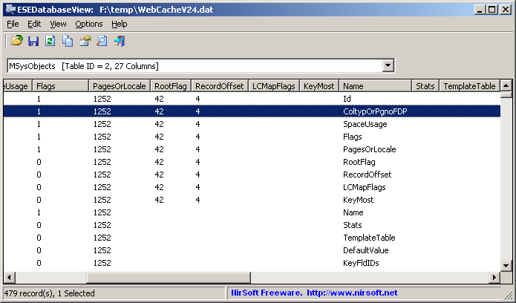
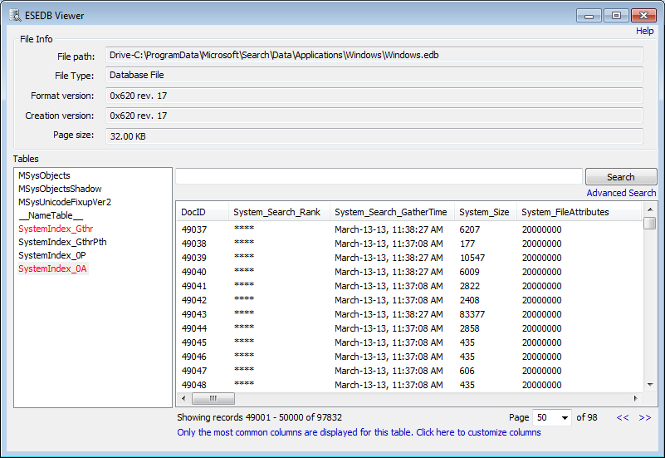
ESE Database View
[1] https://www.nirsoft.net/utils/ese_database_view.html
[2] https://www.osforensics.com/esedb-viewer.html

Slide 54
Non-graded hands-on exercise
- Web Browsing Forensics
Where is the browsing history of Chrome Web browser stored?
Notes:
Next, I have one more non-graded hands-on exercise for you to have fun. Figure out where the browsing history of Chrome Web browser is stored.

Slide 55


Many Online Instant Messaging Services to Chat with Friends
Chat histories?
Notes:
There are many Online Instant Messaging Services to Chat with Friends. Where can we find these Chat histories?

Slide 56

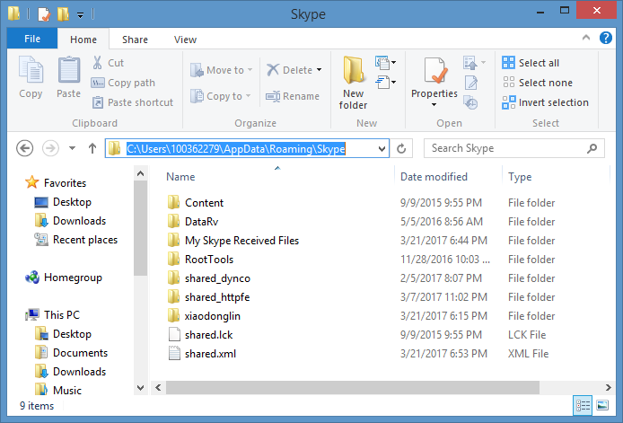
user account name
Received files
A folder named after your Skype Name
a main.db database file that contains the local history
Notes:
Let us take a look at Skype as an example.
In Windows 8, you go to C:\Users\<Username>\AppData\Roaming\Skype, where 100362279 is the username.
[click]
You can will find a folder named after your Skype Name.
[click]
Inside it, you will find a main.db database file that contains the local history
[click]
Also, you can find all your Received files in the subfolder “My Skype Received Files”

Slide 57
Non-graded hands-on exercise
- Instant messaging chat forensics
Where is the chat history of Microsoft Teams stored?
Notes:
Next, I have one more Non-graded hands-on exercise for you to have fun. Figure out where the chat history of Microsoft Teams is stored.

Slide 58

Thumbnail Forensics
Compared with the full-scale display, a smaller version or reduced-size versions of an image, movie or page
Notes:
The next topic in Windows Forensics I would like to discuss is Thumbnail Forensics.
Compared with the full-scale display, thumbnails are a smaller version or reduced-size versions of an image, movie or page. These small pictures or thumbnails are stored in a special file called a thumbnail cache database.
These thumbnail databases can be read using special software and used as evidence in both civil and criminal cases.

Slide 59
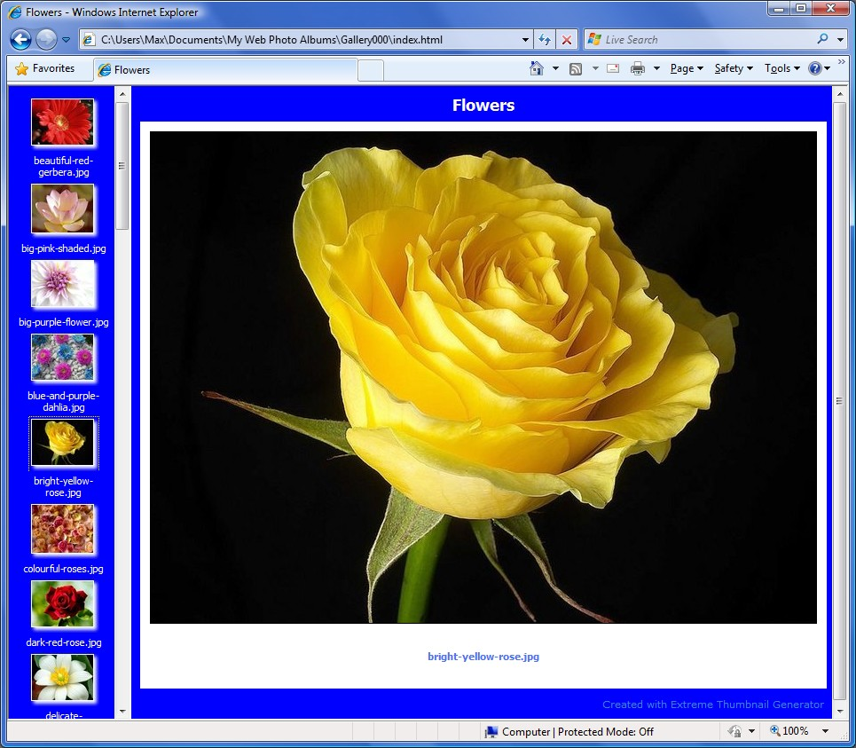
Dose of Reality:
Notes:
For example, when you view your image files in a folder like your My Pictures folder,
you can view the files in a thumbnail format, like a bunch of small pictures. Then, these small pictures or thumbnails are automatically stored in a special file called a thumbnail cache database.

Slide 60

Dose of Reality: (cont’d)
[1] THUMBS.DB: HOW COMPUTER FORENSICS CAN REVEAL TRACES OF A DELETED IMAGE
https://www.intaforensics.com/2009/05/15/thumbs-db-how-computer-forensics-can-reveal-traces-of-a-deleted-image/
Notes:
Even the original image file is deleted, its thumbnail still remains in the thumbnail cache database.
This becomes very useful when a person is suspected of possessing indecent images of children. When a person is suspected of such an offence, the first action by the police is usually to confiscate all their computer equipment so that it can be examined by a computer forensic analyst. The aim of this analysis is to recover any evidence of indecent images on the suspect’s computer.
Often the suspect will have deleted the images before the police reach them. In such cases, computer forensic analysts often look to thumbnail cache database (e.g., the Thumbs.db file on computers running Windows XP to reveal the presence of images, even after they have been ‘deleted’ by the user.

Slide 61
Dose of Reality: (cont’d)
Windows stores thumbnails of graphics files, and certain document and movie files, in the Thumbnail Cache file, called thumbnail cache database.
Notes:
Windows stores thumbnails of graphics files, and certain document and movie files, in the Thumbnail Cache file, called thumbnail cache database.

Slide 62

Thumbs.db
There’s a file called Thumbs.db in almost every one of the folders on your computer. Thumbs.db is a system file generated automatically by Windows XP when you view the contents of a folder in “Thumbnail” or “Filmstrip” view.
Thumbs.db contains a copy of each of the tiny preview images generated for image files in that folder so that they load up quickly the next time you browse that folder. Thumbs.db also stores your settings with regard to thumbnail and filmstrip view.
It is a hidden file not viewed by most users. This gives a secondary chance that someone will leave behind at least partial evidence of an image in their Windows folders. Thumbnails are reduced-size versions of pictures, serving the same role for images as a normal text index does for words.
Thumbs.db no longer exists in Windows Vista (Windows 7). This data has been moved, and uses a centralised thumbnail cache for each user located at:
C:\Users\<username>\AppData\Local\Microsoft\Windows\Explorer\
Notes:
Particularly, there’s a file called Thumbs.db in almost every one of the folders on your computer. Thumbs.db is a system file generated automatically by Windows XP when you view the contents of a folder in “Thumbnail” or “Filmstrip” view.
It is a hidden file not viewed by most users.

Slide 63

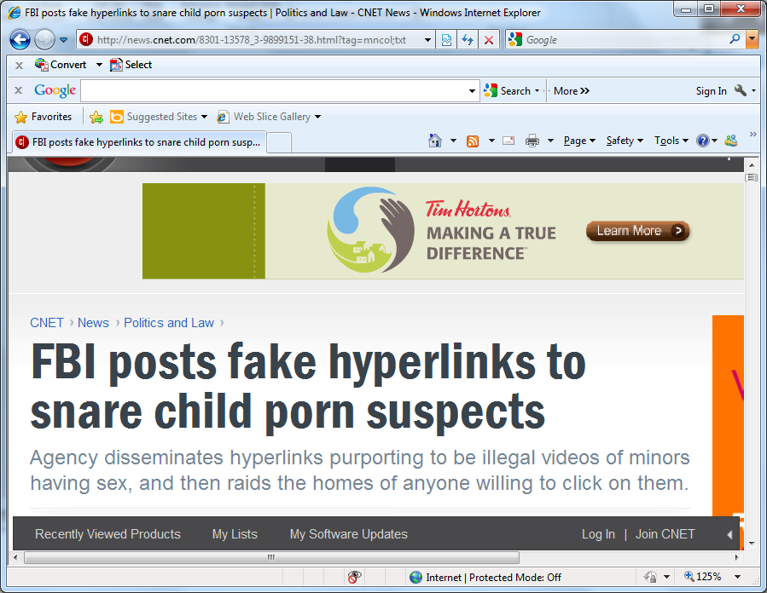
The FBI used the "thumbs.db" file in 2008 as evidence of viewing depictions of child pornography.
Notes:
Thumbnails are used in a wide variety of cases, mostly to attempt to establish whether or not an image file existed on the computer at some point in the past.
For example, the FBI used the "thumbs.db" file in 2008 as evidence of viewing depictions of child pornography to catch some child porn suspects.

Slide 64
Vinetto, a forensics tool to examine Thumbs.db files.
Notes:
Thumbnails are stored in a special file called a thumbnail cache database.
These thumbnail databases can be read using special software and used as evidence in both civil and criminal cases.
Vinetto is a forensics tool to examine Thumbs.db files.

Slide 65


Attempts to negatively affect the existence, amount and/or quality of evidence from a crime scene, or make the analysis and examination of evidence difficult or impossible to conduct.
Anti-Forensics:
Get rid of Thumbs.db
[1] Anti-computer forensics. http://en.wikipedia.org/wiki/Anti-computer_forensics
[2] Get rid of Thumbs.db.
http://www.ofzenandcomputing.com/zanswers/98
Notes:
As you already know, a criminal may also know the existence of thumbnail cache database. It is very common that the criminal wants to get rid of Thumbs.db. So we talk about Anti-Forensics.
It attempts to negatively affect the existence, amount and/or quality of evidence from a crime scene, or make the analysis and examination of evidence difficult or impossible to conduct.
As a computer forensic analyst, you must be aware of anti-forensics for different Forensic technique.

Slide 66
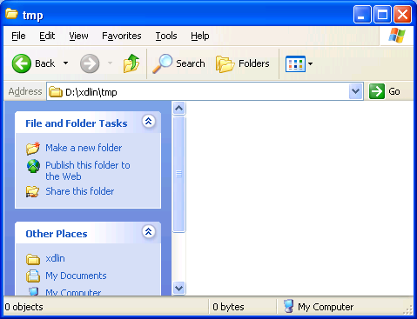
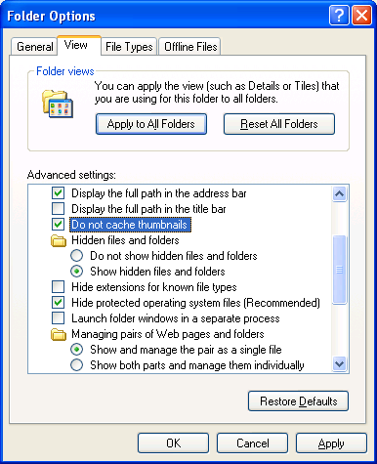
Notes:
For example, you can disable thumbnail caching in Windows.

Slide 67
Microsoft Word Document Forensics
Notes:
The next topic in Windows Forensics I would like to discuss is Microsoft Word forensic analysis.
Document forensics remains an important field of digital forensics. Because of the great popularity of Microsoft Office, many important business documents such as contracts and memo are created using Word. As such, some of these documents become key evidence and subject to forensic authentication during a digital investigation.
Therefore, Microsoft Word forensic analysis is something digital forensic investigators do quite often.

Slide 68
In Word, Excel, and PowerPoint, certain types of hidden information are automatically saved as you work on files, mainly to help you locate the files later by using built-in search tools. This hidden information is often referred to as metadata or data about data.
The topic of metadata has become increasingly relevant as the rise of electronic discovery puts a growing number of vital business documents into the hands of opposing parties for litigation or other business matters. Thus, decoding Microsoft Office metadata is crucial to some investigation.
[1] Control metadata in your legal documents.
http://office.microsoft.com/en-us/help/HA011400341033.aspx
Notes:
In Word, Excel, and PowerPoint, certain types of hidden information are automatically saved as you work on files, mainly to help you locate the files later by using built-in search tools. This hidden information is often referred to as metadata or data about data.
The topic of metadata has become increasingly relevant as the rise of electronic discovery puts a growing number of vital business documents into the hands of opposing parties for litigation or other business matters.
Thus, decoding Microsoft Office metadata is crucial to some investigation.

Slide 69
What type of information is stored?
It is estimated that more than 75% of all newly created documents are shared or collaborated on electronically. In these documents, you can find a rich history of hidden information, for example:
User name and computer name
Comments and tracked changes that may not be displayed
Hidden text, worksheets, data columns, and data rows
......
Nice!
[1] Word Forensic Analysis And Compound File Binary Format
https://www.forensicfocus.com/articles/word-forensic-analysis-and-compound-file-binary-format/
Notes:
What type of information is stored?
A lot of important information which are of interest to digital forensic investigators, such as User name and computer name.

Slide 70

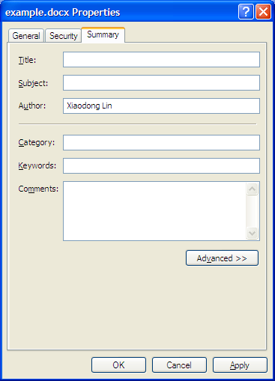
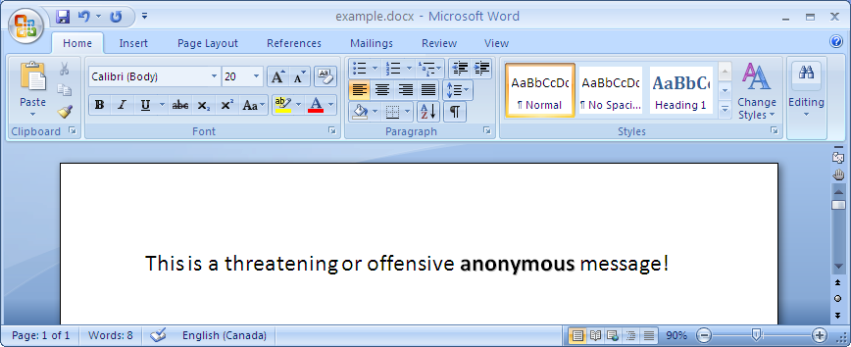
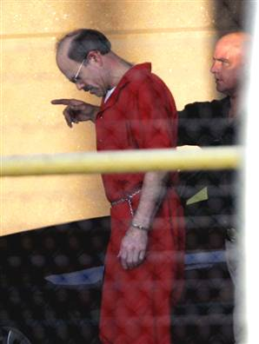
BTK ("bind, torture and kill") Killer
Dennis Rader, a.k.a. BTK Killer, was convicted of a string of serial killings that occurred over a period of sixteen years. Towards the end of this period, Rader sent letters to the police on a floppy disk. Metadata within the documents implicated an author named "Dennis" at "Christ Lutheran Church"; this evidence helped lead to Rader's arrest.
Aside from uncovering evidence to assist the prosecution in high-profile murder cases, an in-depth knowledge of computer forensics is integral when presenting digital evidence for legal proceedings.
Notes:
Recall the story about a serial killer whose nickname is BTK Killer. He was caught by the police officer because of some documents he sent to the police.
These documents contain some metadata showing that the author’s name is "Dennis" who is from "Christ Lutheran Church"; this evidence helped lead to his arrest.
[click]
Suppose you suddenly receives an anonymous and offensive document. So you want to figure out who is the bad guy behind it.
[click]
So you check out the metadata of the document. You see the author’s name is Xiaodong Lin.
[click]
So you know the bad guy behind it is Xiaodong Lin.
This is just a joking example. Please be advised that these metadata information can be easily forged and modified.

Slide 71
wmd.pl, a Perl script written by Harlan Carvey to extract metadata from a Microsoft Word document.
[1] wmd.pl, https://gist.github.com/kost/eb95e623f1b286aee890
[2] Harlan Carvey, Windows Forensic Analysis DVD Toolkit, Elsevier, Jun. 5, 2007
Notes:
wmd.pl, a Perl script written by Harlan Carvey to extract metadata from a Microsoft Word document.
Harlan Carvey is the author for his famous book on Windows Forensic Analysis.

Slide 72
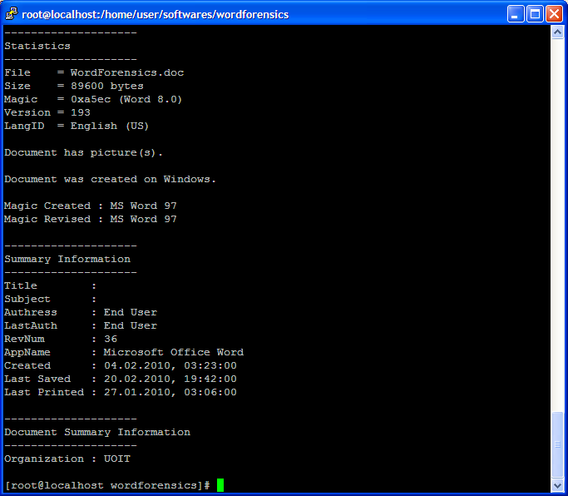
Notes:
This is an example output of wmd.pl.
[click]
It can be observed that the word document is created by someone from an organization called UOIT.

Slide 73
Anti-Forensics
Remove Hidden Data
You have a variety of options for dealing with metadata, including:
Tools included with Microsoft Office
Tools offered by other companies
Notes:
Similarly, you must be aware that a suspect can remove these hidden data.

Slide 74
Windows Event Logs
Notes:
In an event of a forensic investigation, Windows Event Logs serve as the primary source of evidence as the operating system logs every system activities. Windows Event Log analysis can help an investigator draw a timeline based on the logging information and the discovered artifacts.

Slide 75
Windows Event Logs
In Windows, an event is any significant occurrence in the system or in a program that requires users to be notified, or an entry added to a log. The Event Log Service records application, security, and system events in Event Viewer.
The Windows Event Logs are used in forensics to reconstruct a timeline of events.
With the event logs in Event Viewer, you can obtain information about your hardware, software, and system components, and monitor security events on a local or remote computer.
Event logs can help you identify and diagnose the source of current system problems, or help you predict potential system problems.
Event Log Types: A Windows computer records events in the following three logs:
Application log
Security log
System log
Notes:
In Windows, an event is any significant occurrence in the system or in a program that requires users to be notified, or an entry added to a log.
The Windows Event Logs are used in forensics to reconstruct a timeline of events.
The main three components of Windows event logs are:
Application
System
Security

Slide 76
Application Log
The application log contains events logged by programs.
For example, a database program may record a file error in the application log. Events that are written to the application log are determined by the developers of the software program.
Notes:
The Application Log records application related events that are installed in the system. This records the errors that occur in an application, informational events, and warnings from the software applications. Using the Application log we can troubleshoot any software problem that prevents it from either logging in or functioning properly.

Slide 77
Security Log
The security log records events such as valid and invalid logon attempts, as well as events related to resource use, such as the creating, opening, or deleting of files.
For example, when logon auditing is enabled, an event is recorded in the security log each time a user attempts to log on to the computer. You must be logged on as Administrator or as a member of the Administrators group in order to turn on, use, and specify which events are recorded in the security log.
Notes:
The Security Log contains Logon/Logoff activity and other activities related to windows security. These events are specified by the system’s audit policy. The security log is the best and last option to detect and investigate attempted and/or successful unauthorized activity. Event logs can also be used to troubleshoot problems in the system.

Slide 78
System Log
The system log contains events logged by Windows system components.
For example, if a driver fails to load during startup, an event is recorded in the system log. Windows predetermines the events that are logged by system components.
Notes:
The System Log records events that are logged by the Operating System components. These events are frequently pre-established by the working OS itself. System log files may contain data about hardware changes, device drivers, system changes, and all activities related to the machine.

Slide 79
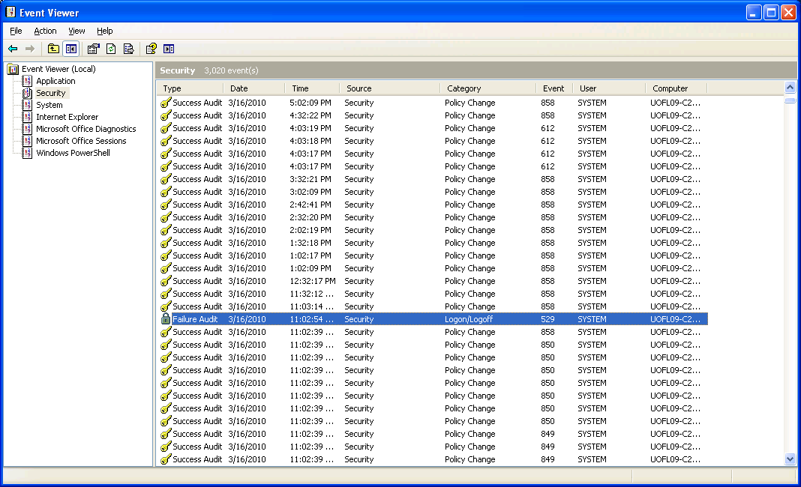
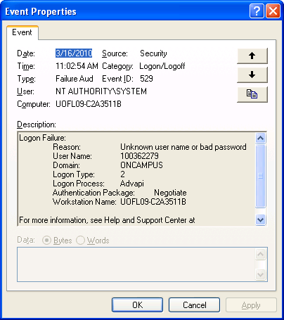
Notes:
You can use Event Viewer to look at the Windows Logs.
[click]
This is an example of failed login attempt in Windows Event Logs.

Slide 80
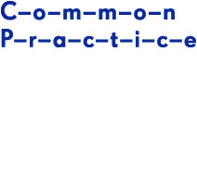
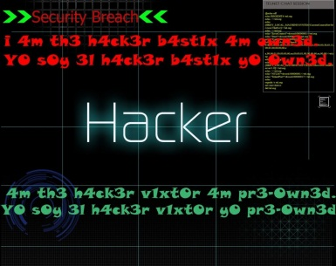

Anti-Forensics
The hacker always clear log files after having done something on the compromised computer system.
Notes:
Now you know why the hacker always clear log files after having done something on the compromised computer system.

Slide 81




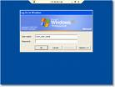
Centralized Log Management
IDS alerts
Anti-virus alerts
Firewall logs
……
Authentication server logs
Notes:
However, we can defeat such kind of Anti-Forensics by using Centralized Log Management. Centralized Log Management is a type of logging solution system that consolidates all of your log data and pushes it to one central location, which is well-protected as well.

Slide 82

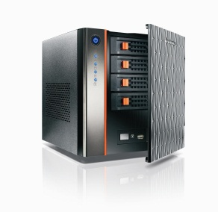
Why Centralized Logging?
Allows logs for many systems to be checked on a single system
No need to log into multiple systems to figure out what is happening
Allows for more powerful data mining on log files
Provide trail when compromised
Most importantly, more secure
Notes:
There are some good reasons about the Centralized Log Management.
From the security perspective, it still provides trail when a system is compromised and the hacker clears log files after having done something on the compromised computer system. It is because the centralized log server has a copy of the log from the compromised computer system. Also, it will be much easy to well protect one centralized log server instead of protecting all the computer systems in an organization.

Slide 83
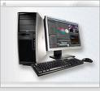



iptables
Syslog
Syslog NG collector
snort
Syslog
APACHE Web Server
Windows
[1] http://www.cyberciti.biz/tips/force-iptables-to-log-messages-to-a-different-log-file.html
[2] http://www.jessland.net/JISK/IDS_IPS/Log_Analysis/Tools.php
Notes:
Next, let’s do a case study on centralized log management.
Assume that a big company has implemented a centralized logging infrastructure. The company deploys an Intrusion Detection System (IDS) using Snort. Also, the company installs a VPN server, which allows teleworkers to remotely access the company network.
The system administrator also maintains an asset database which contains the details of assets in an organization. Examples of asset details are OS, IP address, MAC
address, hardware manufacturers, hardware types.
Also, Active Directory is used to manage users, authenticating and authorizing users and computers in the network and ensuring only authorized users have access to the company resources. The raw log messages from Snort and VPN server along with Active Directory logs are transmitted to a central storage location using Syslog.

Slide 84

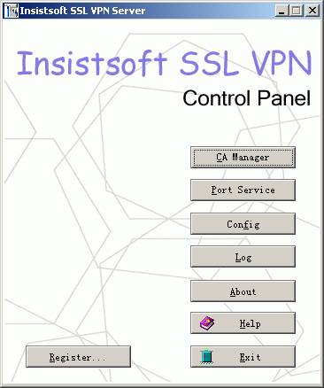
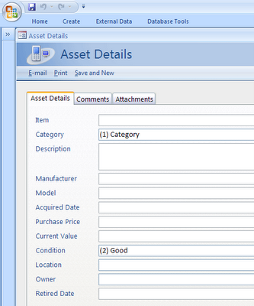

Syslog messages
snort
Syslog collector
VPN server
APACHE Web Server
10.0.0.1
xyz is Joe@Reynolds2210
xyz is using ip blah now
Joe@Reynolds2210 is DoS attacking my Web server
xyz is DoS attacking 10.0.0.1 now
ip blah is DoS attacking 10.0.0.1 now
Notes:
Suppose that the VPN server records a login event for any given user along with a location and timestamp and forwards it to the centralized log server.
[click]
Around the same time as the login event, a DoS attack was detected by Snort, originating from ip address blah against a company computer of IP address of 10.0.0.1.
[click]
Based on VPN server logs, you find out a user with UID xyz is using ip address blah.
[click]
Through event correlation, we now know that the user with UID xyz is DoS attacking a computer of IP address of 10.0.0.1.
[click]
Further, we search asset database and find out that IP address of 10.0.0.1 is assigned to the company web server, which is an important server for the company.
Also, we find the full name of the user with UID xyz by querying Active Directory. Assume that user xyz’s full name is Joe at Reynolds 2210. Finally, we can conclude that user Joe is DoS attacking the company web server.
The conclusion is very helpful in terms of two things compared to the raw log data collected. First, we know who the attacker is. Second, we know this is a critical incident, and therefore it must be given a high priority.

Slide 85

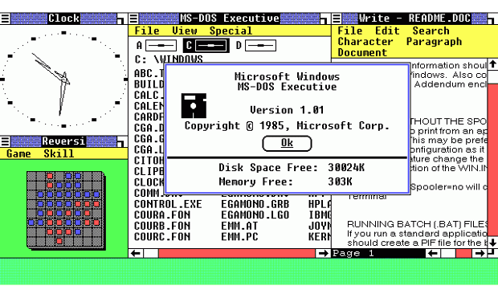
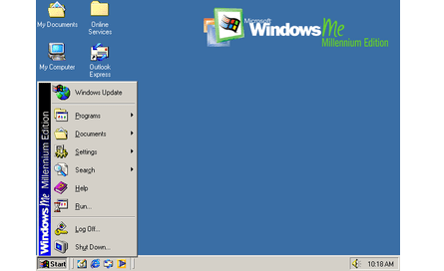


Evolution of Windows OS: From Windows 1 to Windows 10
Many things unknown
Windows 1
Windows 2
-> Windows 3
-> Windows 3.1
Windows 2000
Windows 95
Windows ME
1985
1995
2000
Windows 98
Notes:
Microsoft Windows operating systems have gone through an evolution of several major versions, starting from v.1.0, first introduced in 1985 to today's widely version, Windows 10 in year 2015

Slide 86




Evolution of Windows OS: From Windows 1 to Windows 10 (cont’d)
Windows XP
Windows 7
Windows 10
Windows Vista
2001
2009
2015
Windows 8
-> Windows 8.1
Many things unknown
Notes:
Microsoft Windows operating systems have gone through an evolution of several major versions, starting from v.1.0, first introduced in mid-1993 to today's widely version, v.3.X in year 2000.

Slide 87
Linux Forensics
Notes:
Next, we will look at Linux Forensics.

Slide 88
Linux Forensics
Command history
Linux Logging
Notes:
For Linux Forensics, we will be focusing on two topics,
Command history
Linux Logging

Slide 89


Dose of Reality:
While in the Windows command line, press the F7 key to view a history of all the commands that have been entered in that window.
Notes:
Many Operating Systems maintain a command history for each user account.

Slide 90
Command history
Linux keeps command history across multiple sessions. For example, the bash shell maintains a history of the commands you entered. You can re-execute a command by recalling it from the history, without having to re-type it.
The command history is stored in a file, specified by an environment variable “HISTFILE”.
[root@localhost ~]# echo $HISTFILE
/root/.bash_history
The maximum number of commands that it will save depends on the value of this environment variable “HISTSIZE”
[root@localhost ~]# echo $HISTSIZE
1000
To display the entire command history type: history
hidden file
Notes:
Linux keeps command history across multiple sessions. For example, the bash shell maintains a history of the commands you entered.
The command history is stored in a file, specified by an environment variable “HISTFILE”.
The maximum number of commands that it will save depends on the value of this environment variable “HISTSIZE”
To display the entire command history type: history

Slide 91

Command History (cont’d)
Now I Know What You Did.
Notes:
This is an example output of the history command.

Slide 92
Linux Logging
One of the keys to success in conducting an effective digital investigation on a computer system is to know what is happening on the system.
Linux offers exceptional logging by using the syslog utility,
and the detail in the logs is configurable.
We need to Know how it is configured!
[1] Troubleshooting Linux with syslog.
http://www.linuxhomenetworking.com/wiki/index.php/Quick_HOWTO_:_Ch05_:_Troubleshooting_Linux_with_syslog
Notes:
Similar to Windows Event Logs, in an event of a forensic investigation, system logs in Linux also serve as the primary source of evidence as the Linux operating system logs every system activities.
Therefore, it is crucial to analyze Linux system logs as well.
However, different from Windows Event Logs, Linux offers logging by using the syslog utility, and the detail in the logs is configurable.
[click]
Obviously, we need to how Syslog is configured!

Slide 93
Syslog - A System Logging Facility
Syslog is now standardized within the Syslog working group of the IETF (Internet Engineering Task Force) [1]. Widely used in UNIX/Linux and Cisco
Two key functions
Provides a logging facility for programs/Linux system
Give administrators control over logging
Flexible
Allows messages to be sorted and prioritized
Messages can be routed to various destinations
Log files
Console
Remote hosts for centralized network logging
[1] The BSD syslog Protocol. http://www.ietf.org/rfc/rfc3164.txt
Notes:
Different from Windows Event Logs, Syslog is a standard, Widely used in UNIX/Linux and Cisco
There are two key functions
Provides a logging facility for programs/Linux system
Give administrators control over logging
It is very flexible
Allowing messages to be sorted and prioritized
Messages can be routed to various destinations, including Log files, Console, and Remote hosts for centralized network logging

Slide 94
Dose of Reality:
You can forward Windows Event Log messages to a Syslog Server!
[1] Event Log Forwarder for Windows
https://www.solarwinds.com/free-tools/event-log-forwarder-for-windows
Notes:
You can also forward Windows Event Log messages to a Syslog Server! However, Windows OS does not natively support sending event log data to a Syslog server. So you will need to install a third-party application, for example, Event Log Forwarder for Windows from SolarWinds.
Please note that there are many such free tools available now. I don’t endorse this software application.

Slide 95

Flexible
We have to figure out how syslogd has been configured.
Notes:
So you know you can configure syslog in Linux to store the logs anywhere you want. It provides you with great flexibilities, which is good for us. However, the bad thing is if we want to analyze the logs in Linux, and we will also have to figure out how syslogd has been configured. So we can know the location of the system logs. In other words, we have to understand how to configure syslog in Linux.

Slide 96


Syslog Setup
Syslog Daemon – The rsyslogd logging daemon
Is started at the boot time
Syslog Configuration
/etc/rsyslog.conf controls what gets logged and where it goes
Log repository, e.g.
/var/adm/message
/dev/console
@192.168.230.128 # remote loghost
Now you know where the log files are!
[1] The enhanced syslogd for Linux and Unix - rsyslog.
http://www.rsyslog.com/
Notes:
We will take a look at a specific syslog implementation, which is rsyslog, an enhanced syslog program for Linux and Unix.
It involves three important components:
Syslog Daemon – The rsyslogd logging daemon (also known as background processes), which is a Linux or UNIX program that runs in the background. In Linux, almost all daemons have names that end with the letter "d". Therefore, the Syslog Daemon is named rsyslogd. Linux often start daemons at boot time.
Rsyslogd has a configuration file, /etc/rsyslog.conf, which controls what gets logged and where it goes.
In syslog, you need to define Log repository, i.e., where the log is stored. Possible log repository includes Log files, Console, and Remote hosts for centralized network logging.

Slide 97
/etc/rsyslog.conf
Controls how syslog Daemon handles messages
rsyslog.conf format:
selector <Tab> action
The selector selects which messages will be logged
selector is actually the pair facility.priority
Facility indicate the program sending the message
Priority indicate the severity level of the message
The action describes how messages will be logged, including log files, console, and remote hosts
Notes:
The configuration file, /etc/rsyslog.conf, controls how syslog Daemon handles messages.
It is a text file, and every line in this file is called a rule. Each line or rule has the following format
selector <Tab> action
Specifically, the selector selects what logs will be recorded and saved, whereas the action describes how logs will be saved.
Also, it is worth mentioning here that selector and action are separated by a TAB character, not a whitespace character.
The “selector” has the following format
facility.priority
where facility indicates the program sending the message or whose log and priority indicates the severity level of the message or what log.

Slide 98
/etc/rsyslog.conf (cont’d)
selector
The selector
Special values can be used in a selector
* All possible values
none No values
Multiple facilities with the same priority can be separated by commas
For example, Log anything (mail and authpriv) of level info or higher.
mail,authpriv.info
Multiple selectors can be combined with a semicolon
For example, Log all messages of mail and authpriv of level info or higher.
Mail.*; authpriv.info
Message is logged if its priority is at least as severe as the priority specified.
facility
priority
Notes:
As mentioned in the previous slide, the “selector” has two parts, facility and priority.
Special values can be used in a selector, for example, * means all possible values, and none for no values;
Multiple facilities with the same priority can be separated by commas;
Multiple selectors with the same action can be combined with a semicolon;
Message is logged if its priority is at least as severe as the priority specified.

Slide 99


Facility: the program sending the message
* Some common predefined syslog facilities
Notes:
This able shows some common predefined syslog facilities.

Slide 100
Priority: the severity level of the message
* Some common predefined syslog priority levels
Notes:
This able shows some common predefined syslog priority levels.

Slide 101

system logging important
rsyslog.conf format:
selector <Tab> action
[root@localhost etc]# vi rsyslog.conf
#rsyslog v3 config file
……
# The kern file has restricted access.
kern.crit /var/log/secure
……
facility
priority
selector
Action
Notes:
Next, let us take a look at an example line or rule in the configuration file, /etc/rsyslog.conf.
Note that each line or rule has the following format
selector <Tab> action
where selector and action are separated by a TAB character.
So “kern.crit” is the selector, defining which messages will be logged.
[click]
Also, the “selector” has two parts, facility and priority, where facility indicates the program sending the message or whose log and priority indicates the severity level of the message or what log.
So in this rule, “kern” is the facility, which means that the log is from the Linux kern,
[click]
and “crit” is priority, which means the message is logged if its priority is critical or higher.
[click]
/var/log/secure is action, which means the log messages are saved into the file /var/log/secure.

Slide 102
/etc/rsyslog.conf (cont’d)
The action
Syslog daemon writes messages to location specified by action
Only a single action may be specified per line
Action | Description
filename | Writes message to a file filename on the local machine (filename must exist and be a full path; syslogd will not create it)
@hostname | Forwards message to syslogd on hostname (which must be resolvable via /etc/hosts, NIS, DNS, etc.)
@ipaddr | Forwards message to the host at IP address ipaddr
User1,user2,… | Writes message on listed users’ TTY(s) if logged in
|fifo | Writes message to a FIFO (First In First Out) ( or a named pipe)
* | Writes message all logged in users
Choices of syslog actions
Notes:
In summary, when you configure syslog, you need to define the action, which means how logs will be saved.
In other words, Syslog daemon writes messages to location specified by action. Also, only a single action may be specified per line.
Some choices of syslog actions or log repository includes Log files, Console, and Remote hosts for centralized network logging, which could be specified with an IP address or hostname.

Slide 103

Example /etc/rsyslog.conf
Now you know what type of log information can be found and where they are!
[root@localhost etc]# pwd
/etc
[root@localhost etc]# vi rsyslog.conf
#rsyslog v3 config file
……
# The authpriv file has restricted access.
authpriv.* /var/log/secure
……
facility
priority
action
selector
Notes:
Next, let us do an in-class test together.
The selector “authpriv.*” means we log all the messages from the authpriv facility, which are security/authorization messages.
So based on the rule in the example, where can you find these logged security/authorization messages?
The answer is the file /var/log/secure.
[click]
Now you know what type of log information can be found and where they are!

Slide 104

Example Syslog Messages
Notes:
Next, let us take a look at some logged messages in the file /var/log/secure.
Particularly, we take a look at the underlined message. It shows that someone from 192.168.230.1 tries to log into the system as root on March 17, but failed.

Slide 105
We will need to parse the raw log data into a standard format.
Notes:
However, you may notice that sometimes log messages could be hard to understand. In reality, log messages
comes in different formats, and the format of logs from some devices can be also custom defined.
Therefore, one main task in log analysis is to parse the raw log data into a standard format.

Slide 106

Reading materials
Chapter 14
[1] Computer Forensics: Operating System Forensics.
https://resources.infosecinstitute.com/category/computerforensics/introduction/areas-of-study/digital-forensics/operating-system-forensics/#gref

